Slide 1
The Kinetics of General Planar Motion
Dr. Jacob Moore
Associate Professor of Engineering
Penn State Mont Alto

Slide 2
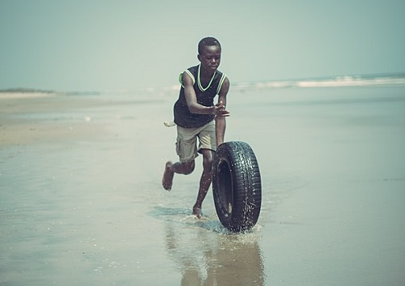
General Planar Motion
General planar motion refers to instances where a body is both translating and rotating at the same time.

Slide 3
Equations of Motion
We now have the tools we need to solve the equations of motion.
In 2D these are...
$$\sum{F_{x}=ma_{x}}$$
$$\sum{F_{y}=ma_{y}}$$
$$\sum{M_{z}=Iα_{z}}$$
Refers to the acceleration of the center of mass of the body
These should both be about the center of mass

Slide 4
Equations of Motion
Alternatively, we could use other directions, as long as they are two perpendicular coordinates…
$$\sum{F_{r}=ma_{r}}$$
$$\sum{F_{θ}=ma_{θ}}$$
$$\sum{M_{z}=Iα_{z}}$$
As long as we are in 2D though, rotation will always be around the z-axis (counterclockwise / clockwise)
Still refers to the acceleration of the center of mass of the body

Slide 5
Kinematics
In addition to the equations of motion, we will also often need to relate the accelerations of the center of mass to the angular accelerations of the body.
In instances such as this, you will need to fall back on your rigid body kinematics to set up equations that relate these variables.

Slide 6
Solving a Rigid Body Kinetics Problem (The Process)
The process used in solving a kinetics problem is similar to solving a problem in statics and consists of three steps.
Set up a free body diagram.
Draw the body separated from it’s surroundings
Draw in all the known and unknown forces (I use red for forces) as well as key dimensions and angles (I use blue for dimensions and angles)
Draw in the acceleration vectors (I use a blue dashed vector for this)
Use the free body diagram to write out your equations of motion, breaking all forces down into x and y components, and writing out all the moments about the center of mass of the body.
These may be supplemented with kinematics equations to relate the accelerations
Solve the equations for any unknowns.

Slide 7
Thanks for Watching
See other engineering mechanics videos and access the full tool at…

Slide 8
Worked Example
A cylinder with a radius of .15 m and a mass of 10 kg is placed on a 20º ramp. If the cylinder is released from rest and rolls without slipping, find...
The initial angular acceleration of the cylinder
The time required for the cylinder to roll 5m
r = 150mm
m = 10kg
20º

Slide 9
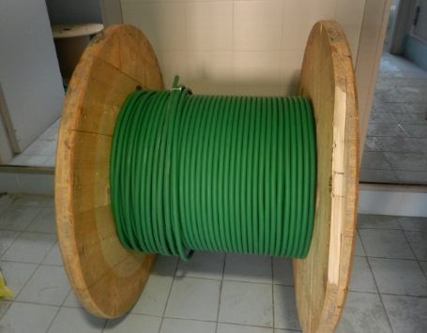
Worked Example
The spool shown below is 50lbs and has a moment of inertia of .28 slug ft². If the cable on the spool is pulled and the spool rolls without slipping
What is the friction force between the spool and the ground?
What is the acceleration of the mass center of the spool?
8 in
4 in
T = 50 lbs

Slide 10
Worked Example
You are designing a frisbee launcher to launch a 40 cm, .6 kg frisbee that can be modeled as flat circular disc If you want the frisbee to have a linear acceleration of 20 m/s² and an angular acceleration of 50 rad/s² as shown to the right, what should F₁ and F₂ be?
$$a_{y}=20 m/{s^{2}}$$
F₂
$$α=50 {rad}/{s^{2}}$$
F₁

Slide 11
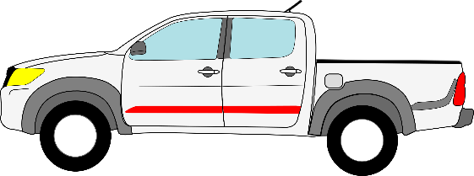
Worked Example
A pickup truck is carrying a 30 kg, 6-meter-long ladder at a 35º angle as shown to the right. The ladder is wedged against the tailgate at A and makes contact with the roof of the truck at B. The distance from A to B is 2 meters. At what rate of acceleration would we expect the ladder to start to rotate upwards?
B
A
$$a_{x}=?$$

Slide 12
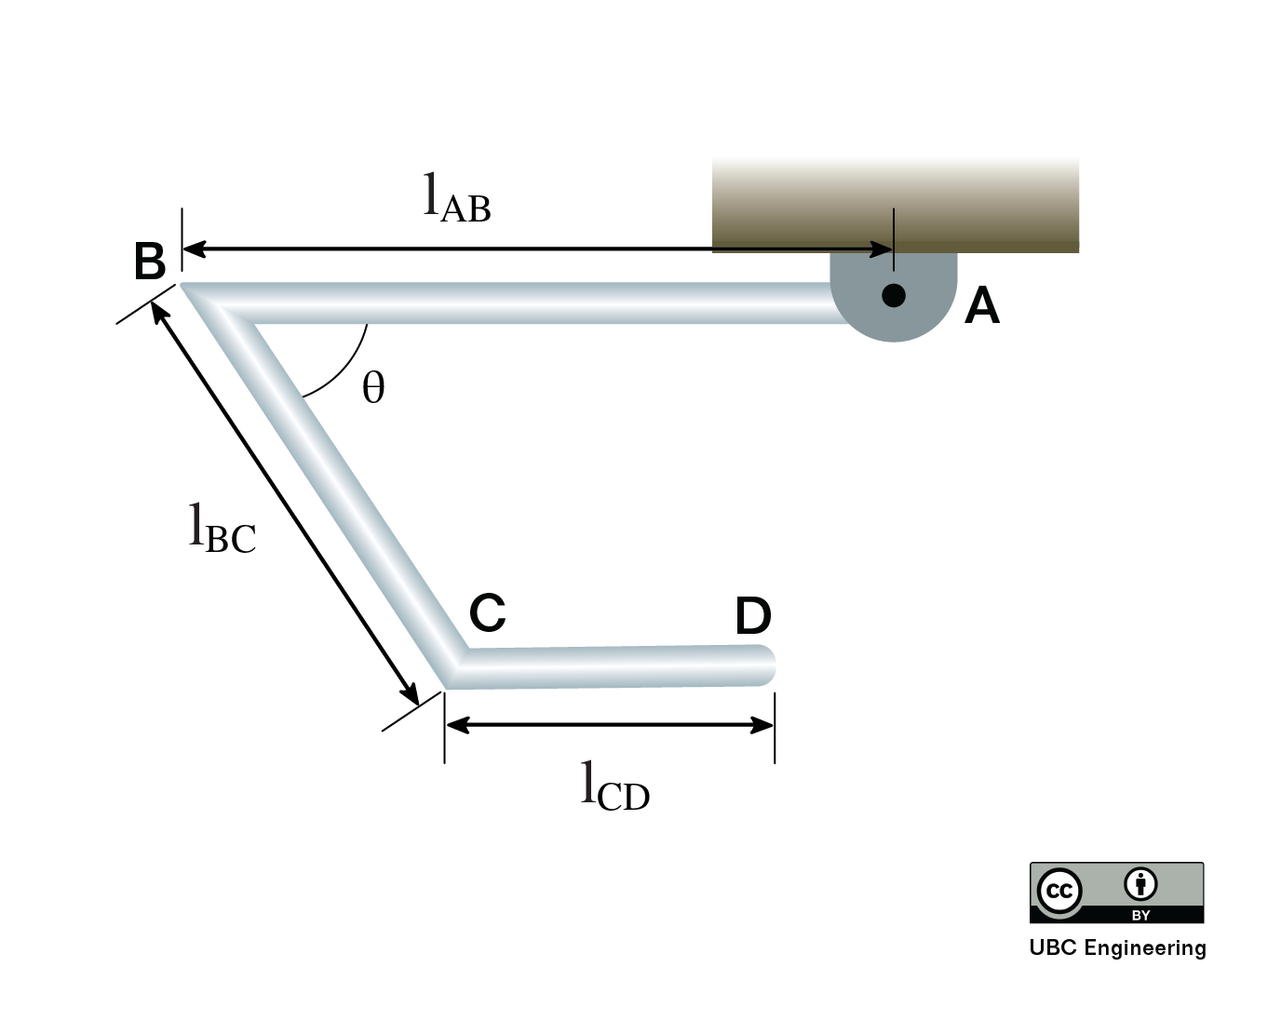
Worked Example
Three slender rods with equal mass are welded together. If the assembly is released from rest, what is the angular acceleration of the rods? The rods have a mass of m=2kg each. Rod AB has a length l_{AB}=1.5m, rod BC has length l_{BC}=1m, and rod CD has length l_{CD}=0.5m. Initially, rod AD and rod CD are perfectly horizontal. Rod BC forms an angle of θ=45deg with rod AB.

Slide 13
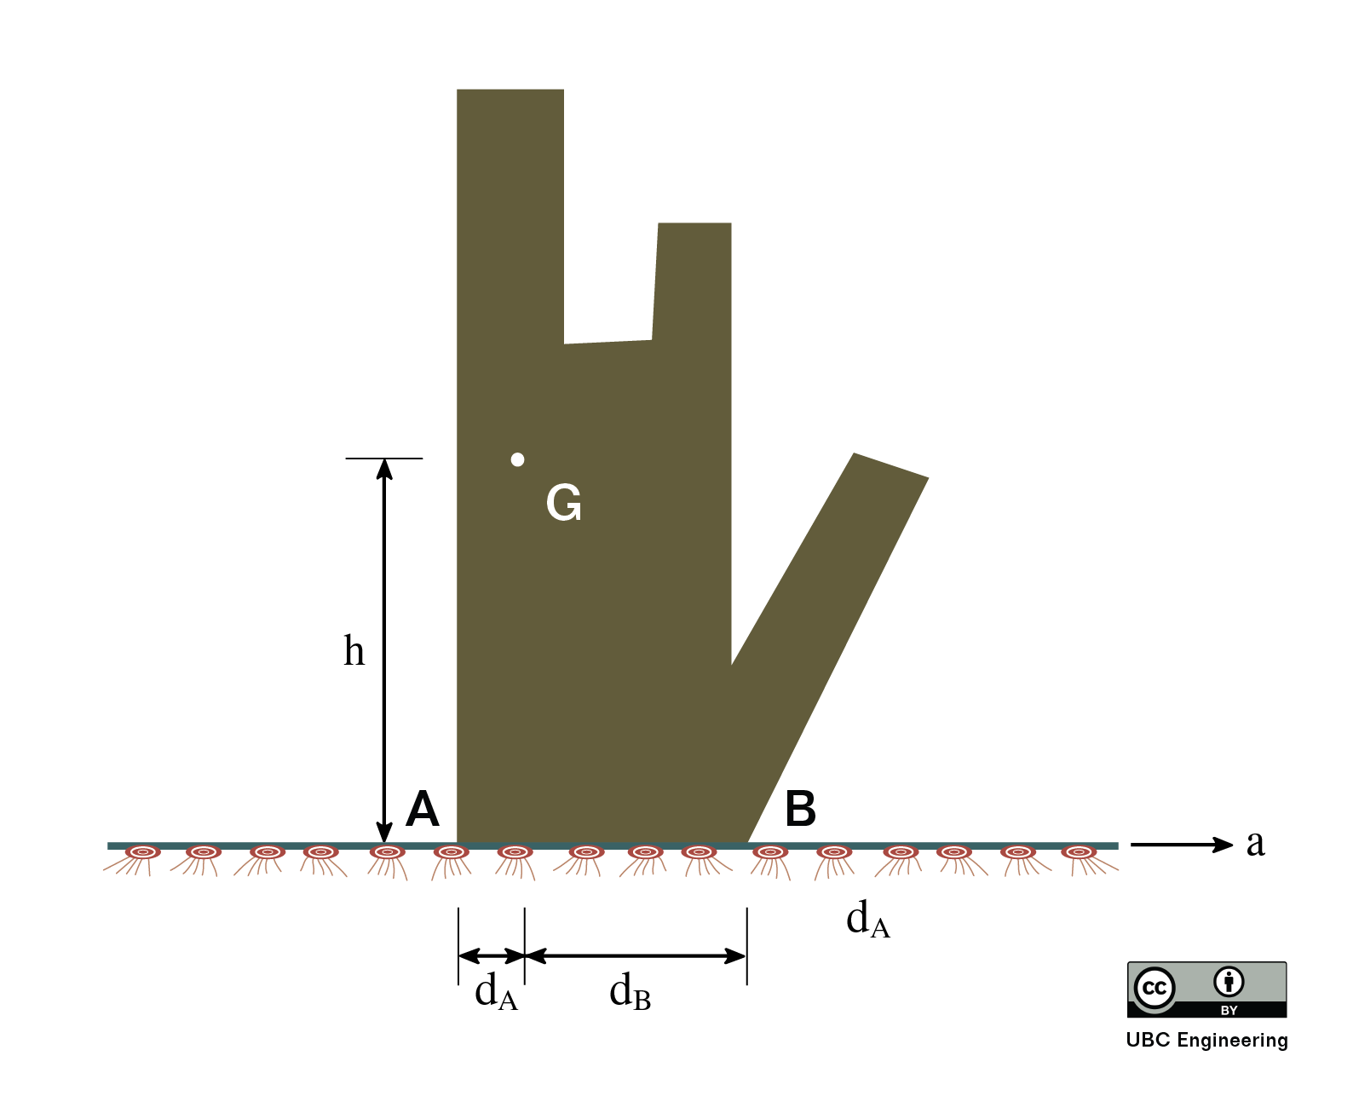
Worked Example
Your friend is once again trying to move their mom’s modern art sculpture by dragging a rug underneath it. Will the statue tip or slip first? Determine the magnitude of the acceleration needed for both tipping and slipping. The statue has a mass of m=80kg and has a radius of gyration k_{G}=0.8m. The coefficient of static and kinetic friction are determined to be μ_{s}=0.25 and μ_{K}=0.2 respectively. Assume there is no friction between the rug and the ground. The center of gravity G is found a height h=1.5m and is a horizontal distance d_{A}=0.1m from point A. Point B is a horizontal distance d_{B}=0.35m away from the center of gravity.

Slide 14
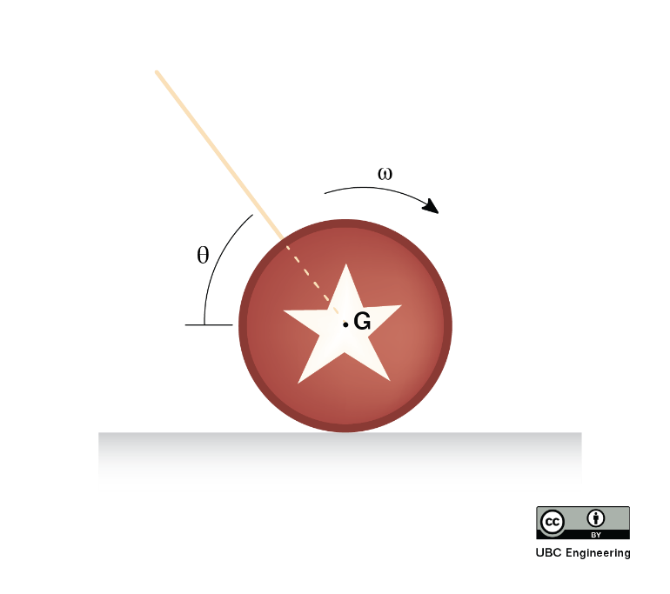
Worked Example
A mechanical engineering student has been practicing his yo-yo tricks because he has too much free time. For one trick, he spins the yo-yo such that it contacts the ground and moves forward, emulating someone walking their dog. If the yo-yo has a radius of gyration k_{G}=0.02m and a mass of m=0.2kg, determine the acceleration and angular acceleration of the yo-yo when the tension in the string is found to be T=0.4N. Assume the string is at its full extent and does not roll up as the yo-yo rolls. Assume there is also no friction where the string slips around the yo-yo’s inner axle. The coefficient of static and kinetic friction are found to be μ_{s}=0.3 and μ_{K}=0.2 respectively. The angle is θ=60 deg and the radius of the yo-yo is r=0.03m. Take the initial angular velocity of the yo-yo to be ω=6 rad/sec.

